Slide 1

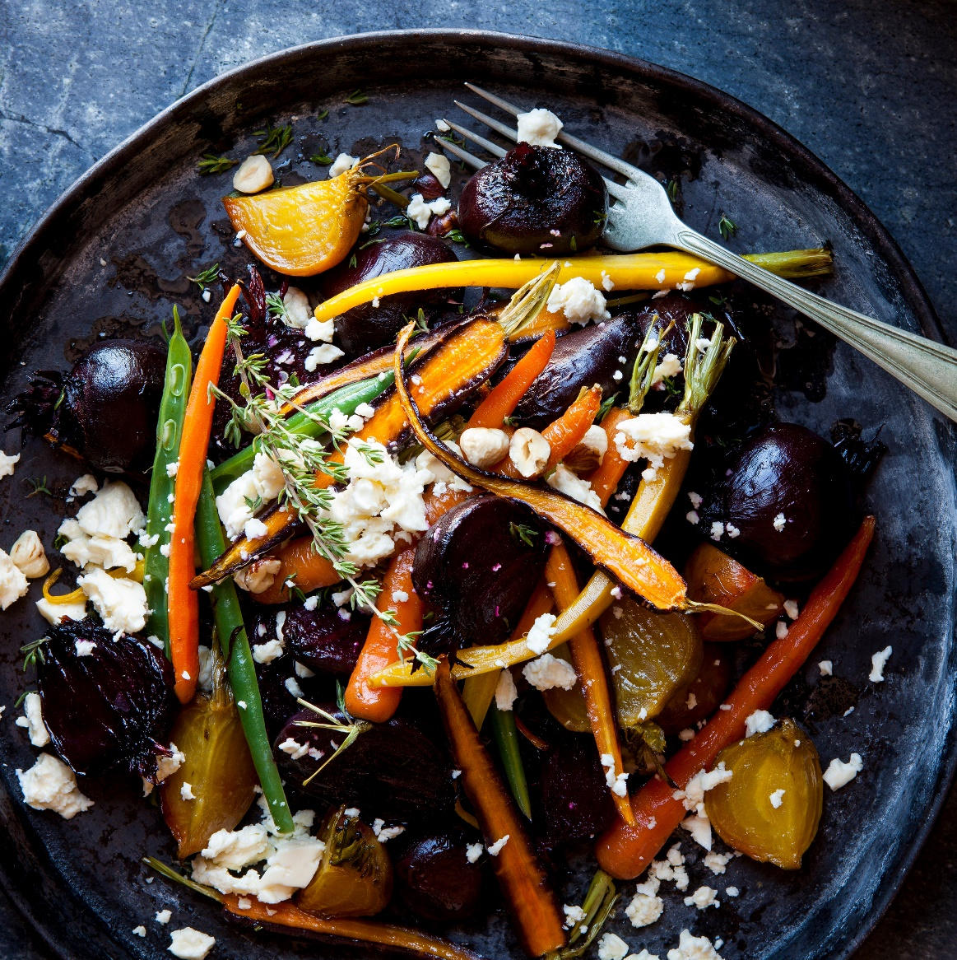
MealMate
Save recipes, track nutrition, live healthily.
COLIN, ELLIOT, Hui, lucy, shuyuan

Slide 2

About
Meal tracker app that lets you save recipes and the different ingredients in it. It shows you the total calories with the nutrition facts.

Slide 3
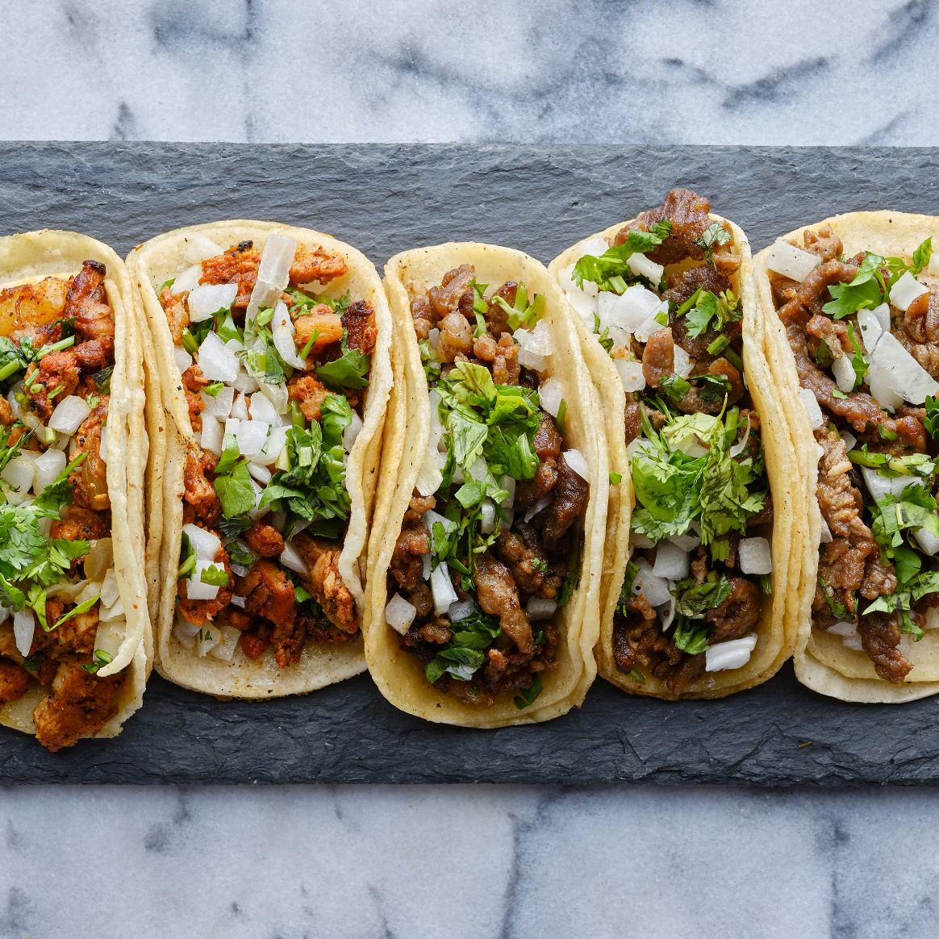
Customer
Individuals whose goals are to eat healthily and keep track of meals.
Notes:
Fitness enthusiasts, home cooks, parents, etc.

Slide 4
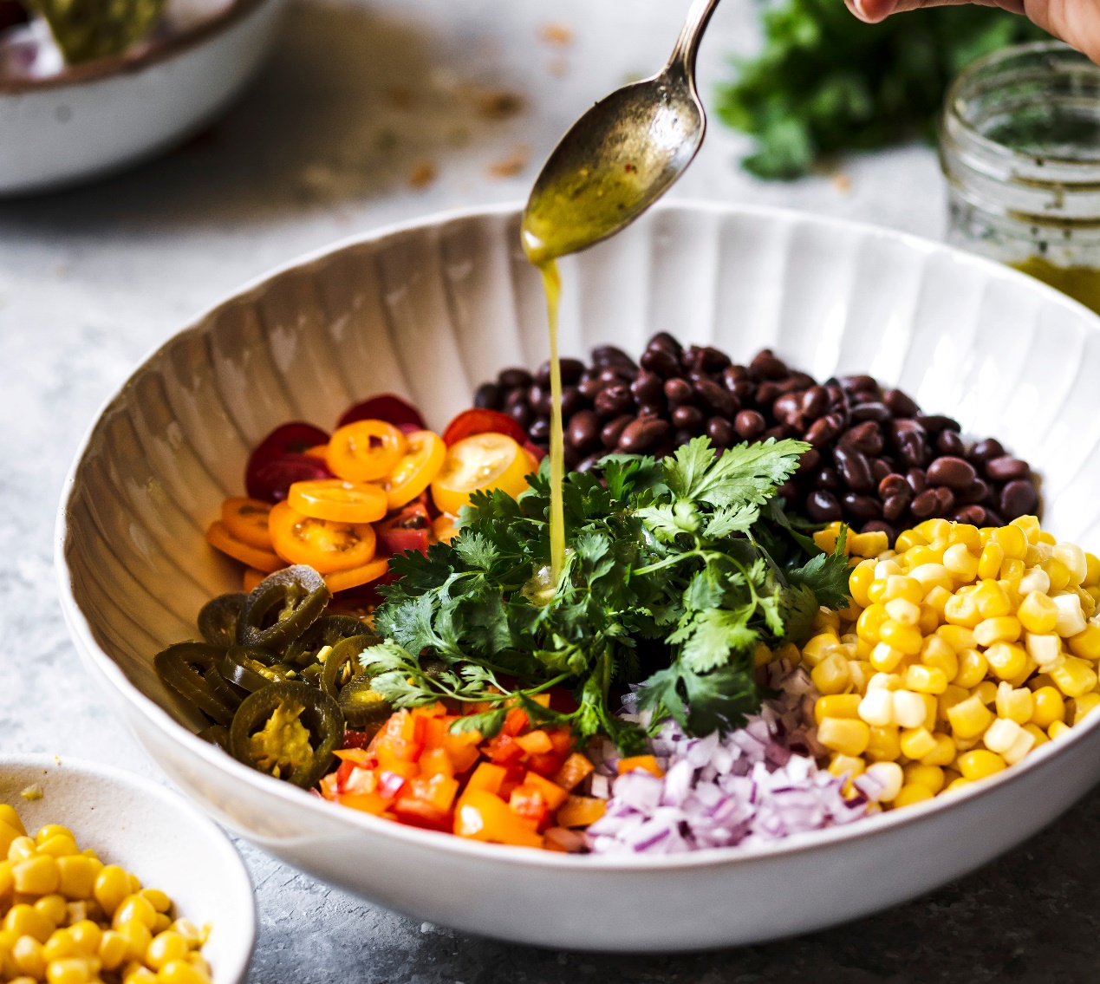

Frontend: Postman
Backend: Spring Boot/MVC, JDBC Template
Endpoints: GET, POST, PUT, DELETE
DTO/DAO/Mapper/Service/Controller: User, Recipe, Nutrient, Ingredient
Database Schema: User, Recipe, Nutrient, Ingredient, recipeIngredient
Notes:
GET /recipes/recipeId
POST /recipes
PUT /recipes/recipeId
DELETE /recipes/recipeId

Slide 5

API
Edamam
Full analysis of food recipes in real time.
Notes:
Submit the full text of any recipe or ingredient list
Edamam will extract the full nutrition and ingredient data from the text
Edamam returns data for calories, fats, carbohydrates, protein, cholesterol, sodium, etc. for a total of 28 macro and micronutrients

Slide 6
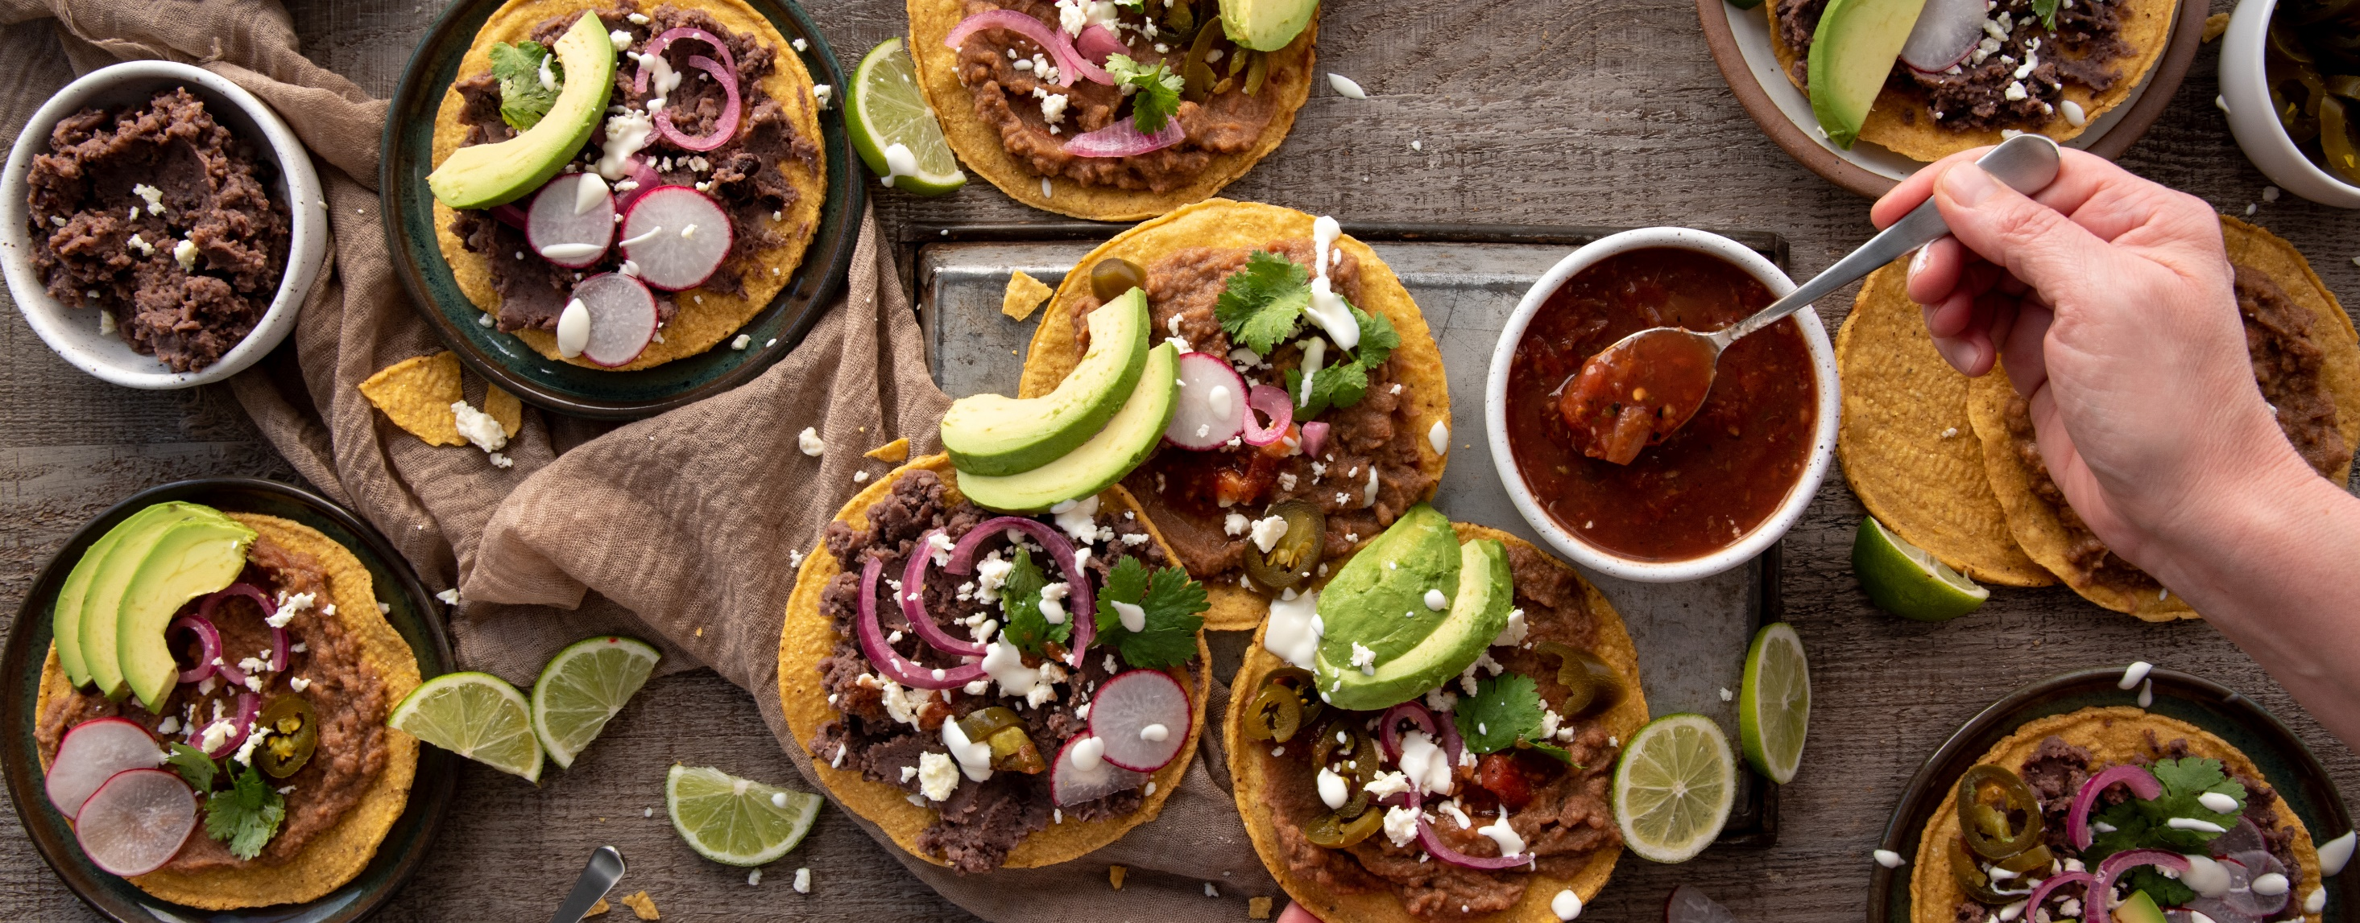
Bon appétit
Mealmate

Slide 7
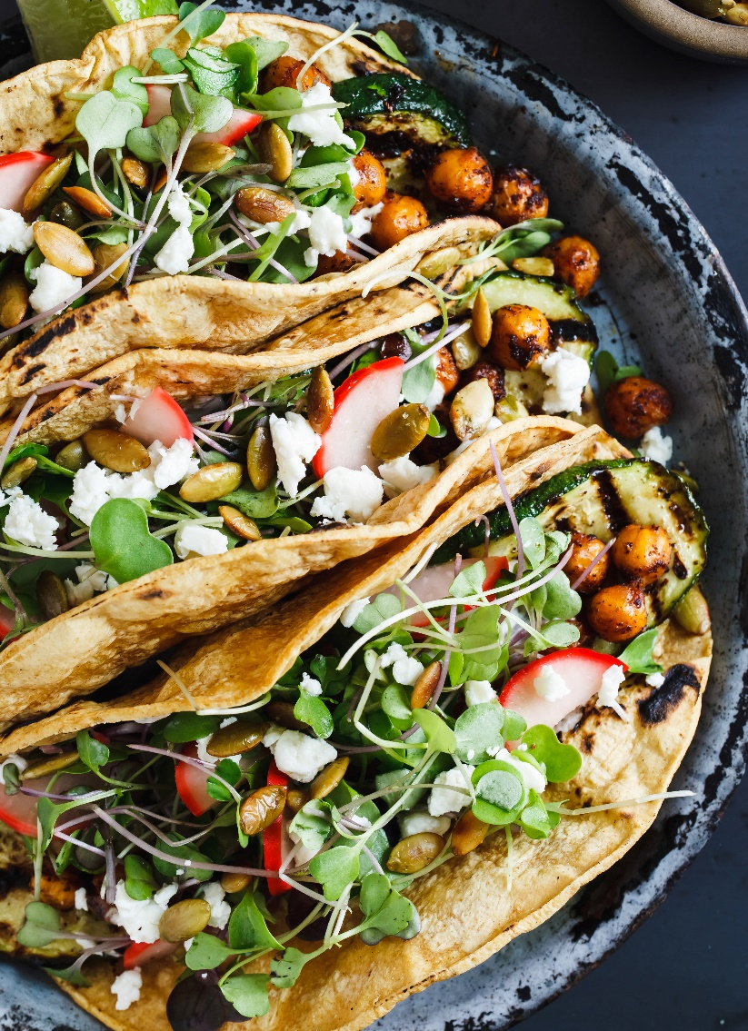
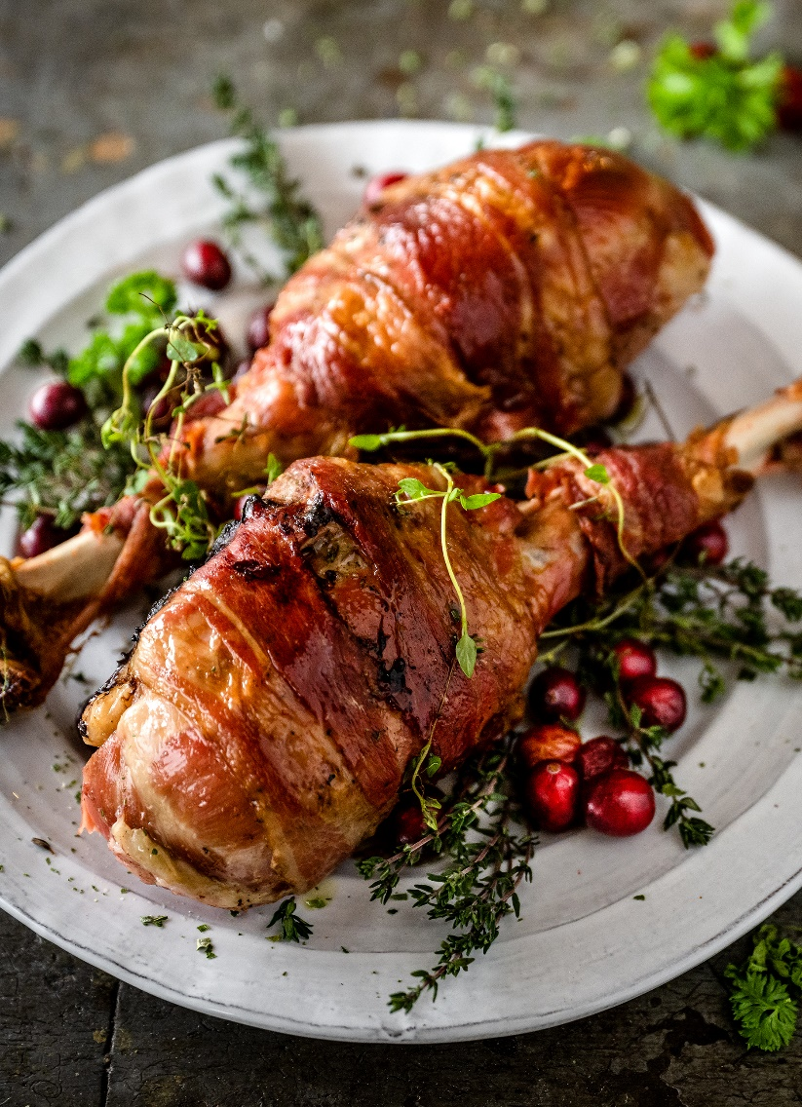

Garden tacos | Olvera
Bacon drumettes | City Café
Shoyu ramen | Larusso's
Grilled zucchini, chickpea, radish, sunflower seed, feta, corn tortilla.
Chicken leg, bacon, hot honey glaze.
Shitake, edamame, firm-pressed tofu, egg, miso, spring onion.

Slide 8

Organic sorbets | Sweetness & Salt
Lavender, pumpkin clove, dark chocolate, lemon, strawberry basil.

